Slide 1
static const int CU_SLOT_CAPACITY_16 = 16;
//number of GPU warp size (constant)
__shared__ CU_SLOT_BUFFER_TYPE
gpu_Type[CU_SLOT_CAPACITY_16], gpu_Zcrd [CU_SLOT_CAPACITY_16], gpu_Znrm[CU_SLOT_CAPACITY_16]; if(thID < CU_SLOT_CAPACITY_16)
{ //copy voxel data from cpu to gpu shared memory. gpu_Type[thID] = cpu_Type [uliSlotDataIdx + thID]; gpu_Zcrd [thID] = cpu_Zcrd [uliSlotDataIdx + thID]; gpu_Znrm[thID] = cpu_Znrm[uliSlotDataIdx + thID]; } __syncthreads();
for (CU_SLOT_BUFFER_TYPE p = 0;
p < CU_SLOT_CAPACITY_16; p++) {//Sorting. Use nVidia reduced summing unsigned int offset = p - (p / 2) * 2; unsigned int iLeft = 2 * thID + offset; unsigned int iRght = iLeft + 1; if (iRght < CU_SLOT_CAPACITY_16) { if (shouldSwap(gpu_Zcrd[iLeft], gpu_Zcrd[iRght])) { swap<T>(& gpu_Type[iLeft], & gpu_Type[iRght]); swap<T>(& gpu_Zcrd [iLeft], & gpu_Zcrd [iRght]); swap<T>(& gpu_Znrm[iLeft], & gpu_Znrm[iRght]); } } __syncthreads(); }
class DLLEXPORT STomoPixel //voxel data
{ public: STomoPixel( INT16* _data_6i); ~STomoPixel(); INT16 x, y, z, nx, ny, nz; int iTypeByte;//alpha, beta, TC, …
};
void inline sortSlotByZ(TPVector& slot, bool _Higher) {//sort voxel data (_Higher) ? std::sort(slot.begin(), slot.end(), _checkHigherPixel) : std::sort(slot.begin(), slot.end(), _checkLowerPixel); }

Slide 2
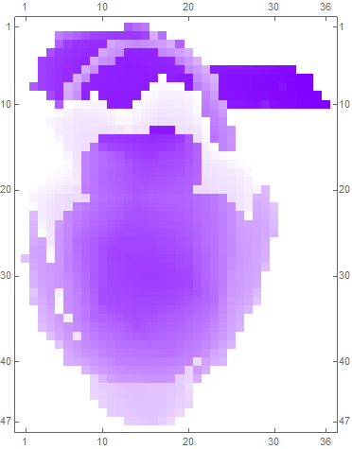
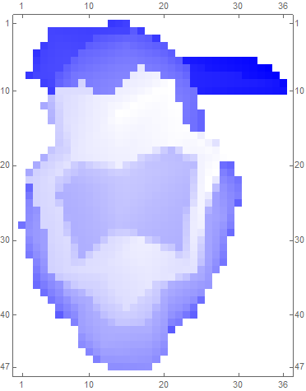
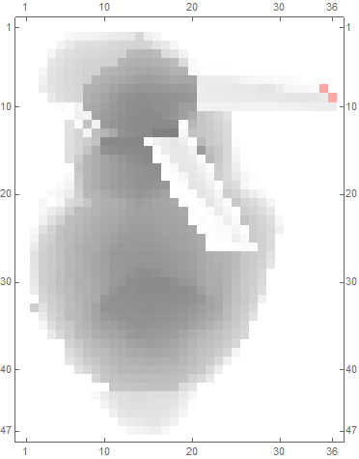
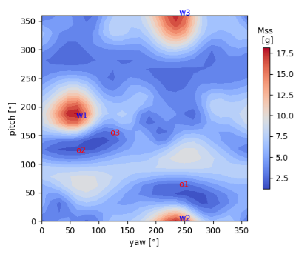
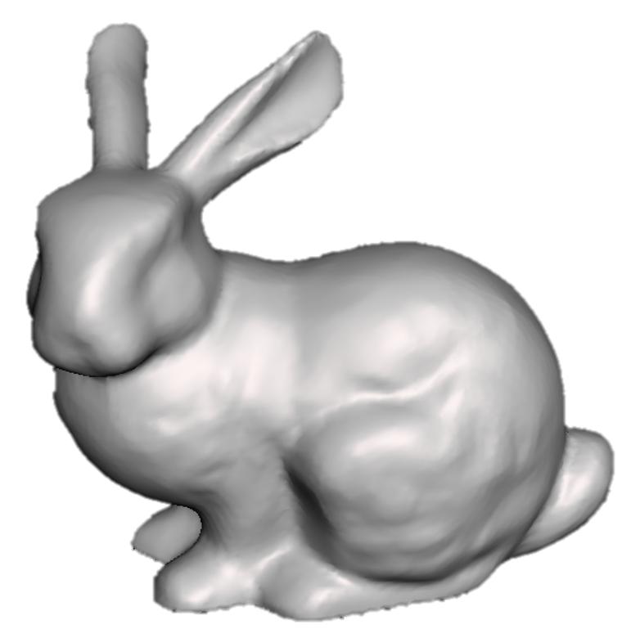
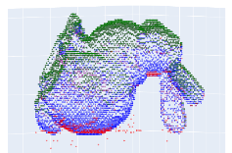
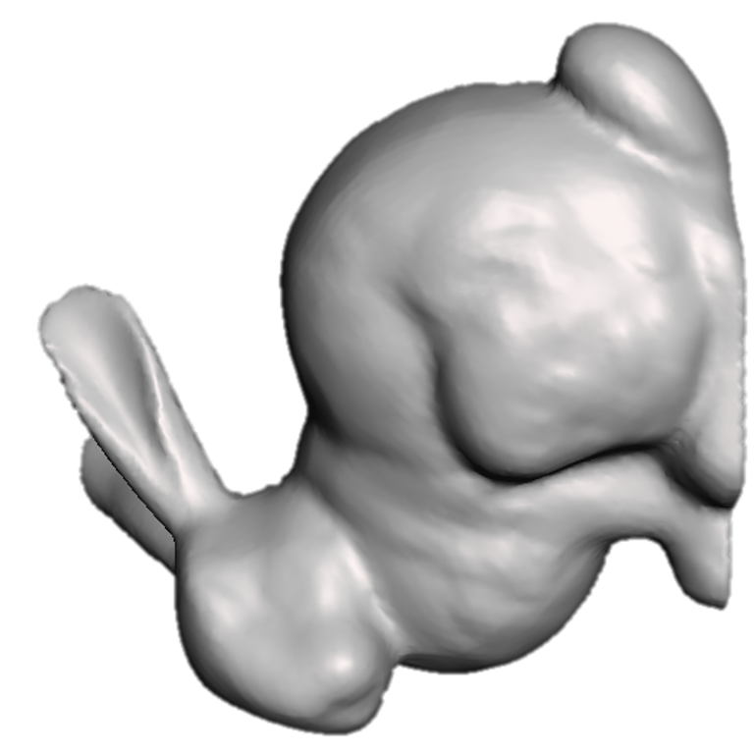
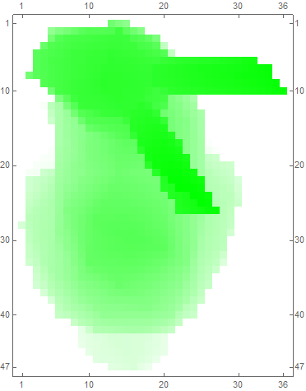
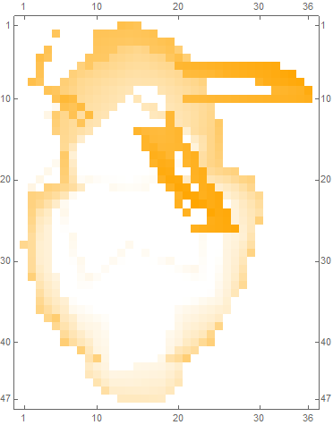
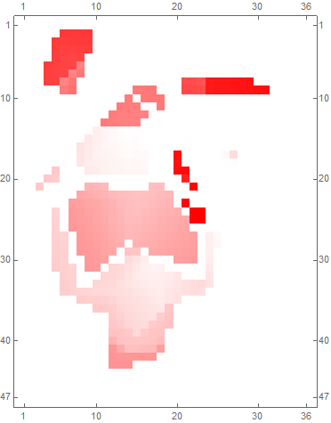
[Modified Support Structure Tomography]
Z (=roll axis)
Z
V_{α}
V _{β}
M_{o}
X
X
(=pitch axis)
-Y
-Y (=yaw axis)
V _{tc}
V _{nv}
M_{ss}
Initial mesh (0°,0°)
Rotate mesh by (yaw, pitch)
Sort each slot and classify pixel group
Integrate volumes
Integrate masses
Plot M_{total} (=M_{o}+M_{ss}) at (yaw, pitch) coordinate
Increase yaw and pitch by θ_{yp} respectively

Slide 3
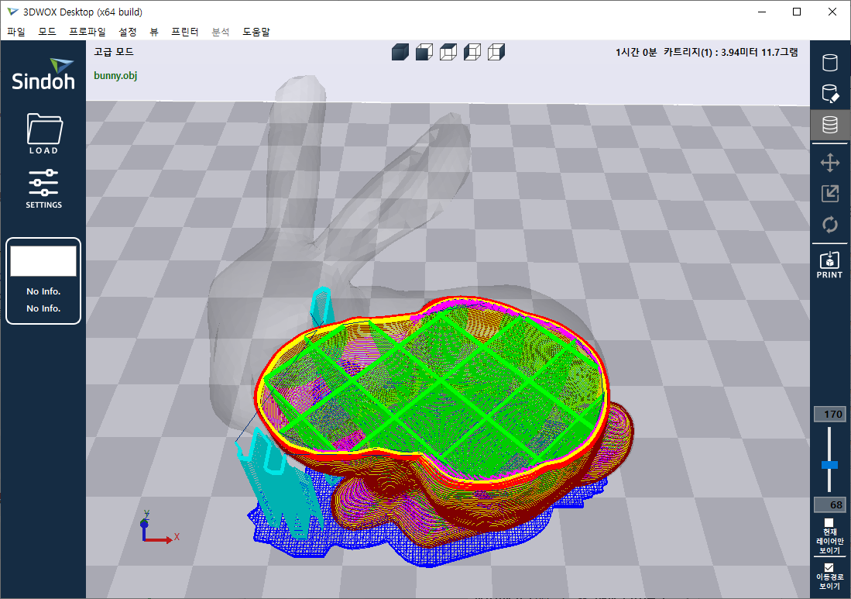
platform
structure
support
structure (“SS”)
wall
(“clad”)
infill
(“core”)
support structure line width / horizontal expansion (“C_{ss}”)
Wall
thickness
(“T_{clad}”)
build plate
(“bottom”)

Slide 4
Y
Slot header
0th pixel
1st pixel
14th pixel
255
Slot (x,y)
_{nV}
V_{o}
V_{ss}
_{Tp}
_{z}
_{nZ}
_{Tp}
_{z}
_{nZ}
_{Tp}
_{z}
_{nZ}
(x,y,*)
₀
₀
₀
₀
₀
₀
₀
₀
₀
₀
₀
₀
₂
₂₂
₃
₁
₃
₋₄₅₆
₂
₂₅
₉₉₉
₀
₀
₀
X
₂
₂₂
₃
₂
₂₅
₉₉₉
₁
₃
₋₄₅₆
₀
₀
₀
0
255

Slide 5
2nd division
(CPU)
1st division
(CPU)
Voxelization
(GPU)
1mm

Slide 6
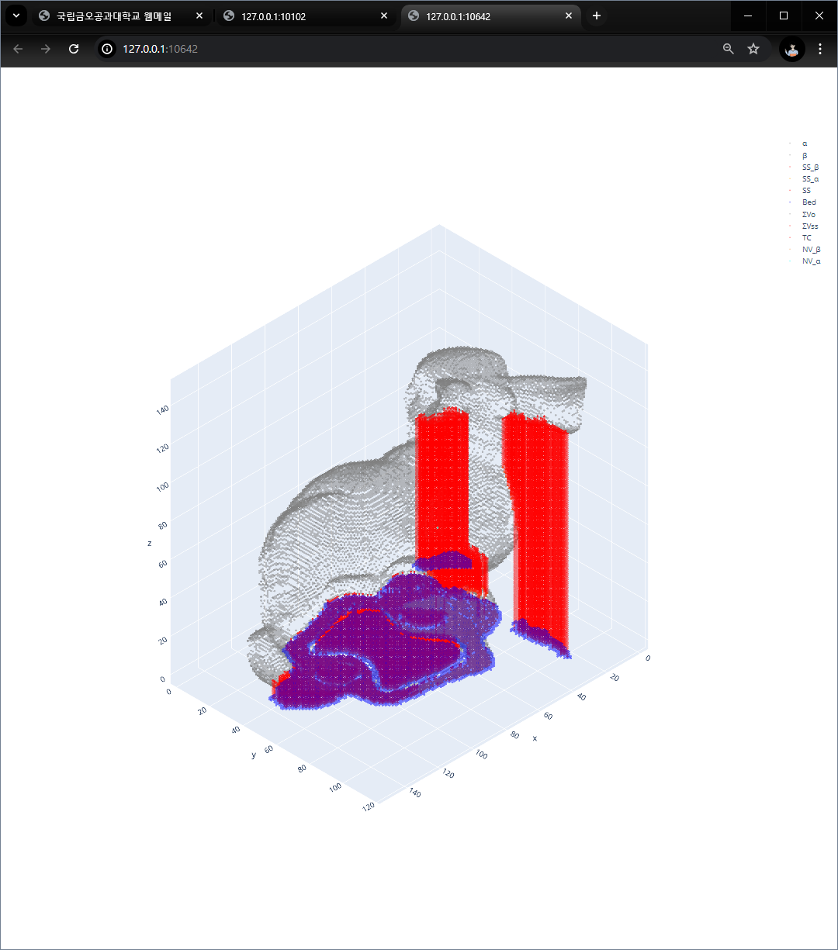
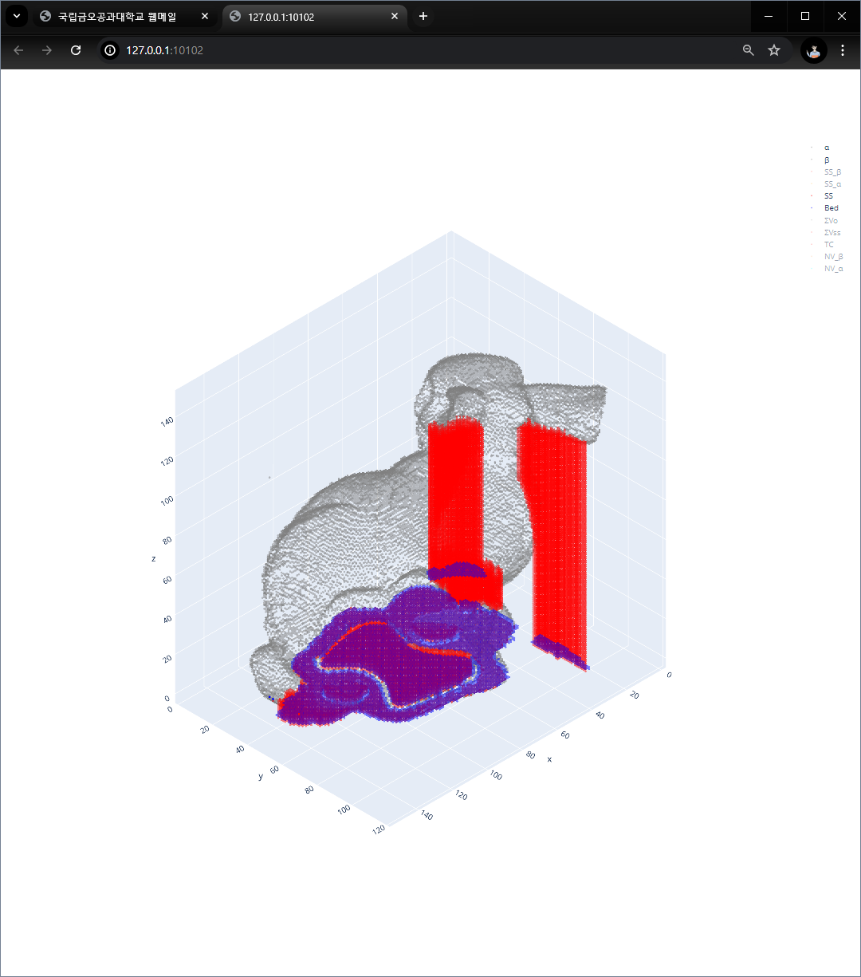
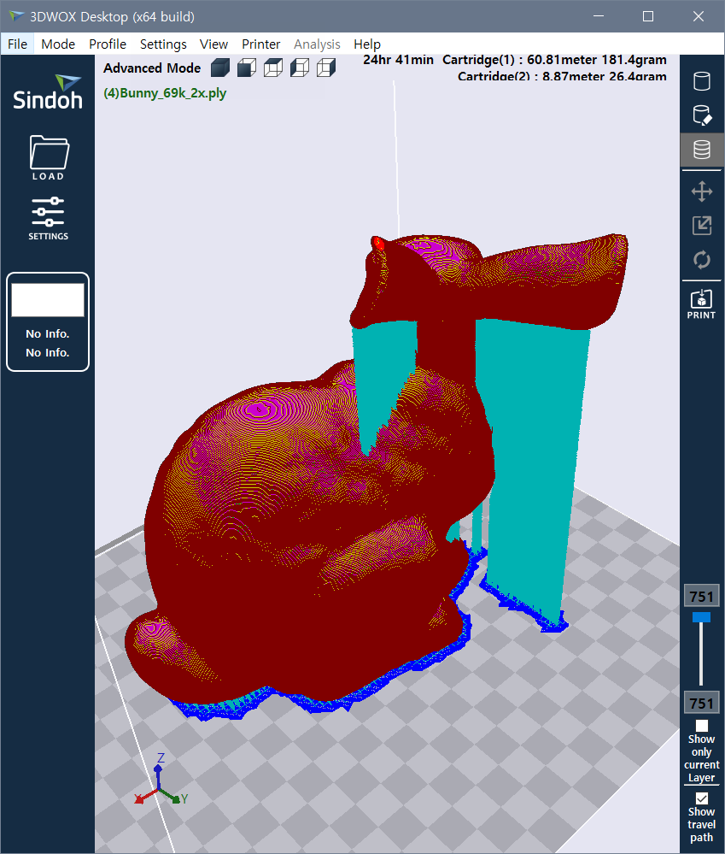
Mo3D= [['169.76']]
Mss3D= [['20.69']]
Mtotal3D= [['190.45']]
Mo3D= [['170.39']]
Mss3D= [['16.99']]
Mtotal3D= [['187.37']]
Mo3D= [[‘181.4']]
Mss3D= [[‘26.4’]]
Mtotal = 207.5
CPU1 (M_{total}= 190.45 g)
GPGPU version (M_{total}= 187.37 g)
Figure 7. voxelization result for Bunny 69k 2x at (0°,0°) orientation (red: support structure, blue: bottom structure)

Slide 7
Slicer Mss
CPU Mss
GPU Mss
Slicer Mo
CPU Mo
GPU Mo
slicer Mss
CPU1 Mss
GPU1 Mss
slicer Mo
CPU1 Mo
GPU1 Mo

Slide 8
Center of mass
2nd division
(CPU)
1st division
(CPU)
Voxelization
(GPU)
1mm

Slide 9
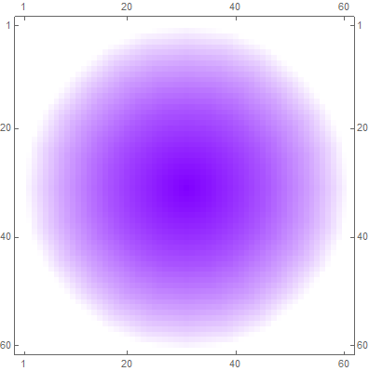
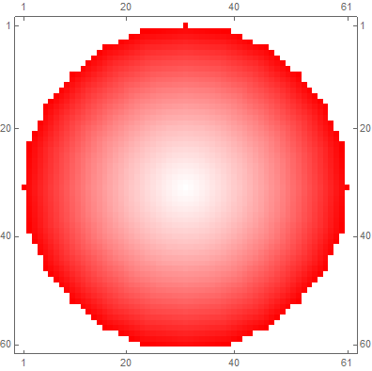

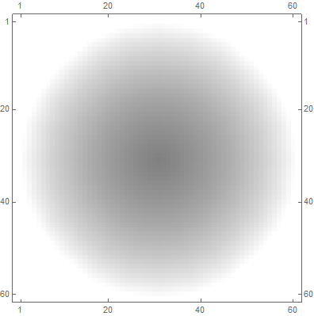
tomoSP (shadow Pyramid) / tomoSO (shadow Orbital)
For each triangle M, repeat
Z (=roll axis)
Find triangle N’s, visible by M within θ_{c}
X
(=pitch axis)
-Y (=yaw axis)
Create pyramid graph for each M/N pair
Initial (yaw, pitch) =(0°,0°)
Composition of all the pyramid graphs
+Vbed
Add shadow volume between bed plate (convex hull)

Slide 10
Y
255
Slot header
0th voxel
1st voxel
2nd voxel
(nV-1)^{th} voxel
(x,y)
Slot (x,y)
_{nV}
V_{o}
V_{ss}
_{Tp}
_{z}
_{nZ}
_{Tp}
_{z}
_{nZ}
_{Tp}
_{z}
_{nZ}
_{Tp}
_{z}
_{nZ}
X
0
255

Slide 11
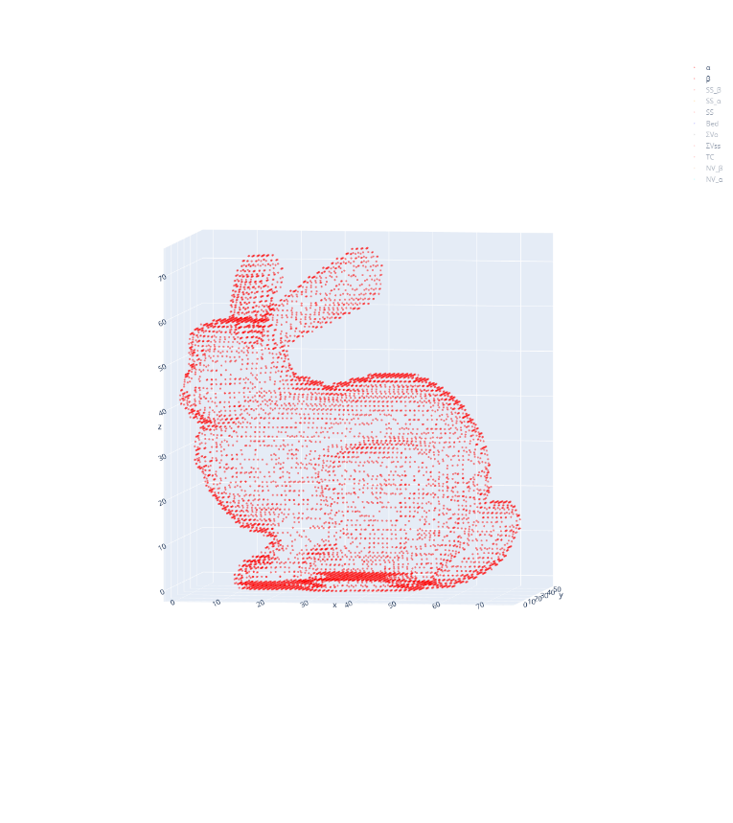
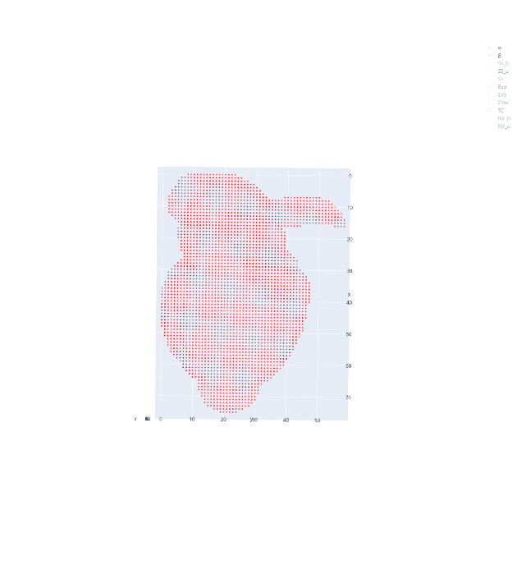
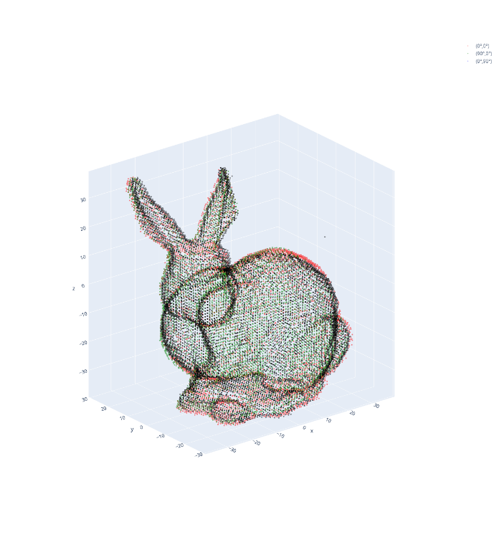
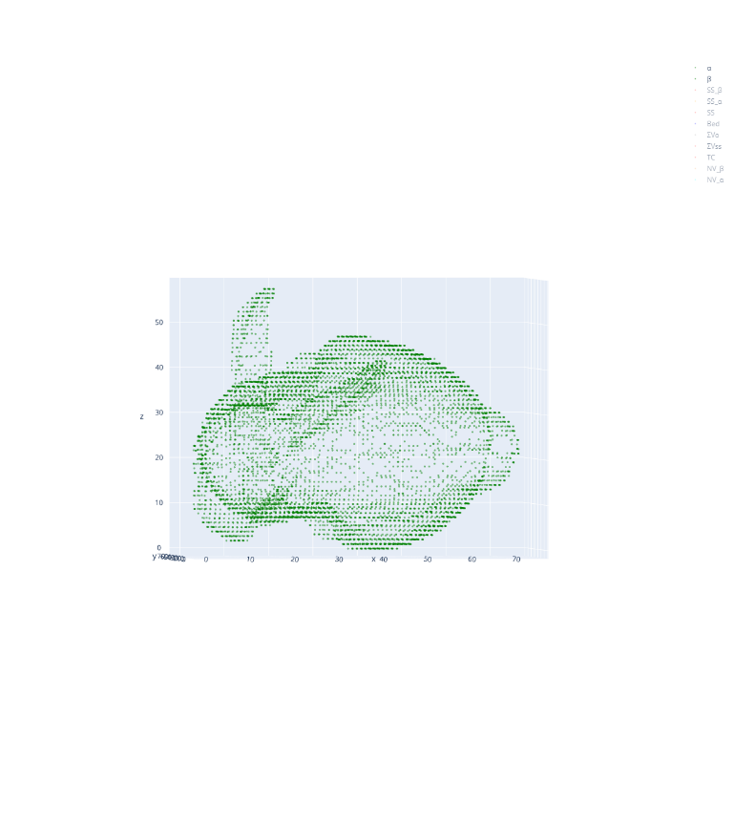
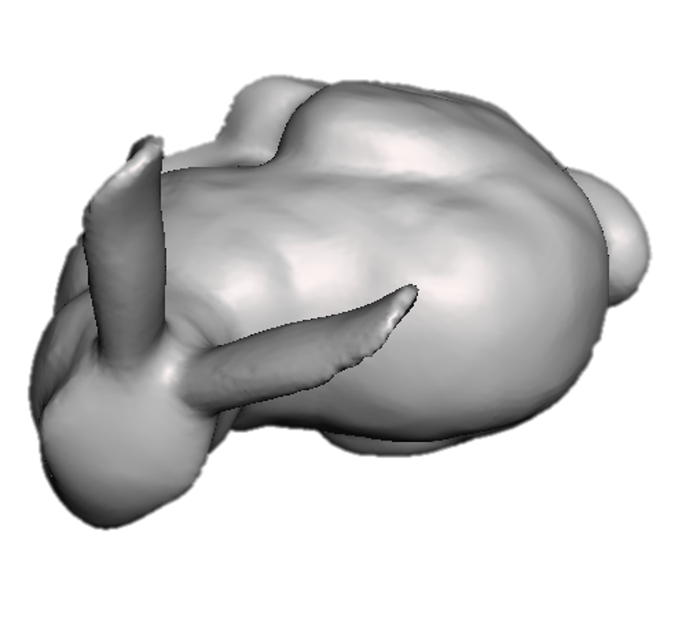
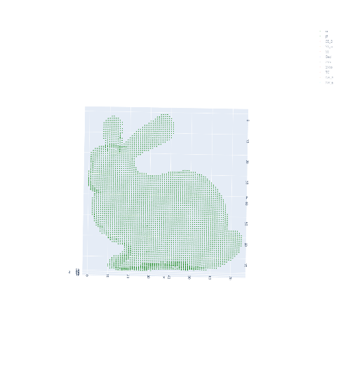
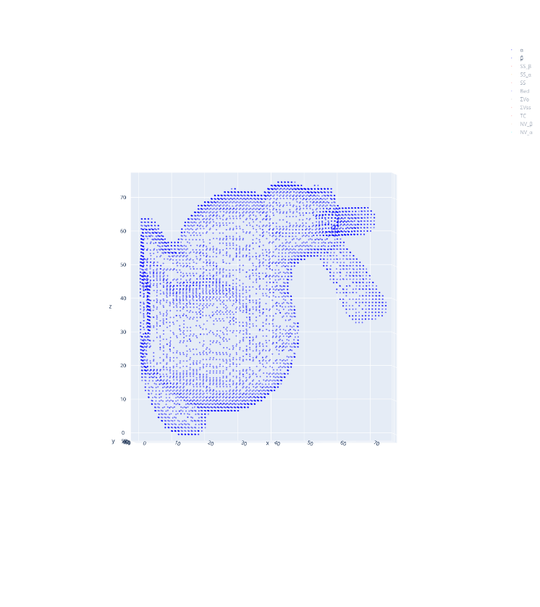
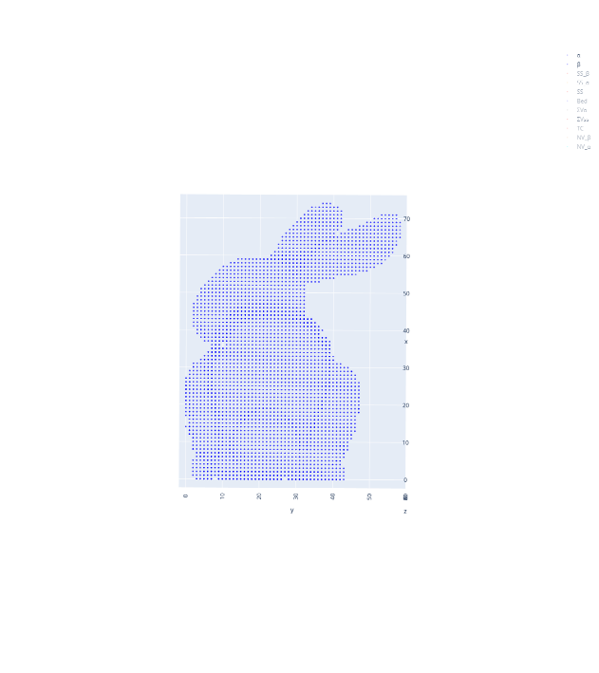
Z (=roll axis)
(top-view)
X (=pitch axis)
-Y (=yaw axis)
Input mesh, (0°,0°)
( 0°, 0°)
VSV at (0°,0°)
(top-view)
(90°, 0°)
Z
( 0°,90°)
rotation
X
Inverse rotation & addition
(90°,0°)
-Y
VSV at (90°,0°)
(top-view)
Z
Final CVV
X
-Y
(0°,90°)
VSV at (0°,90°)

Slide 12
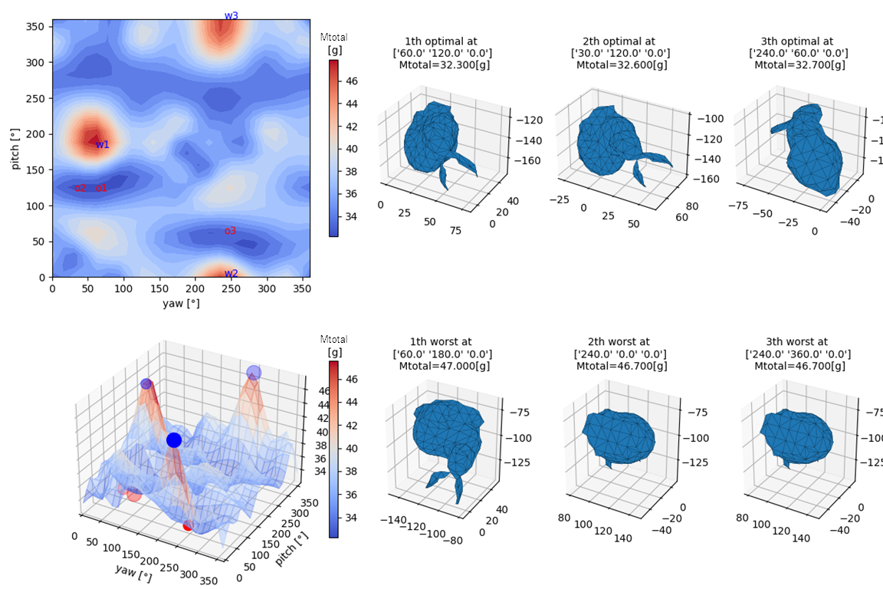
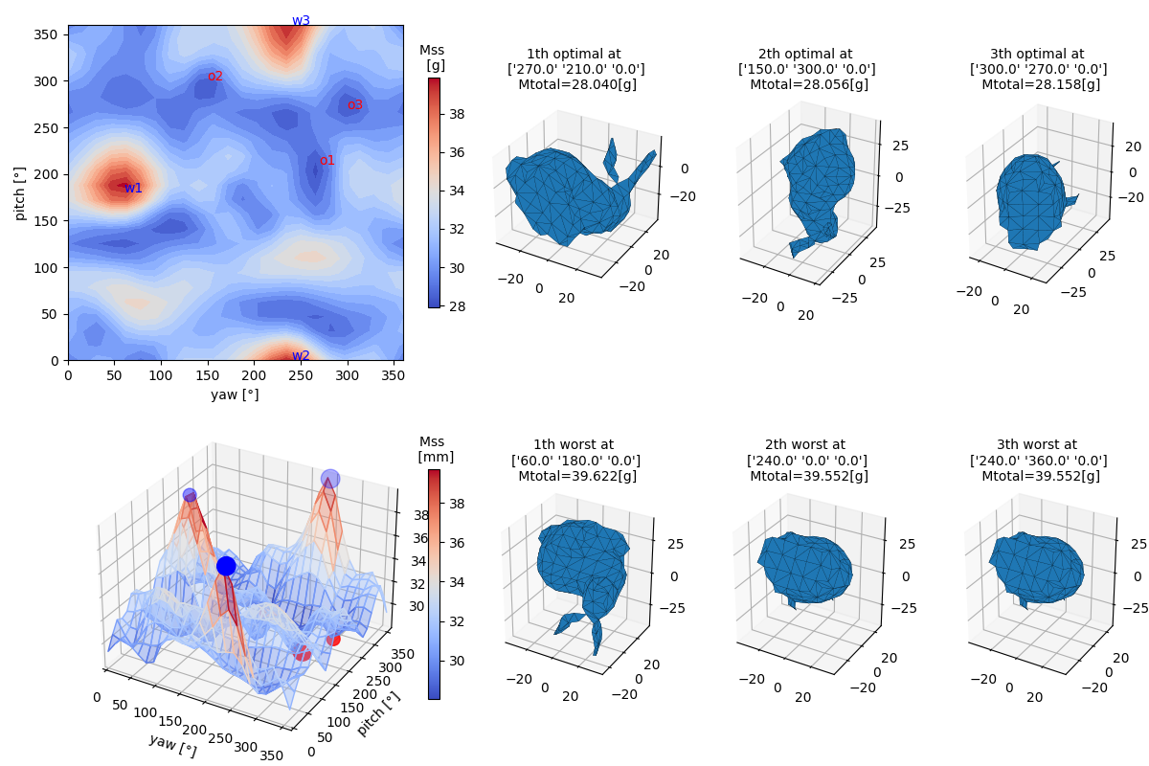
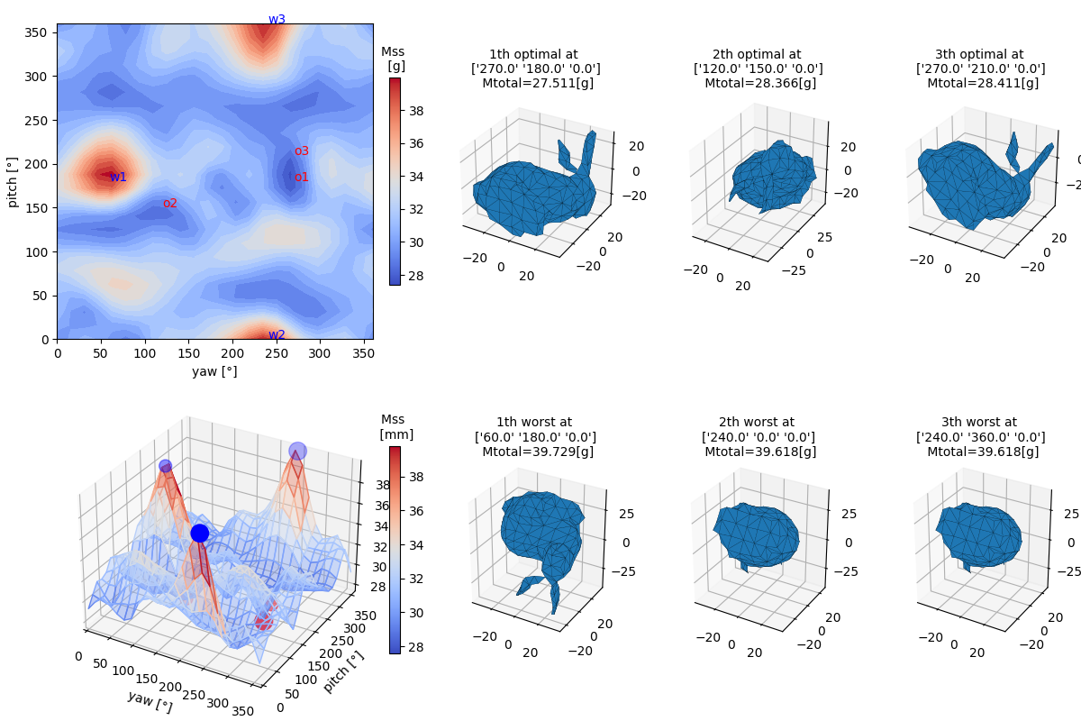
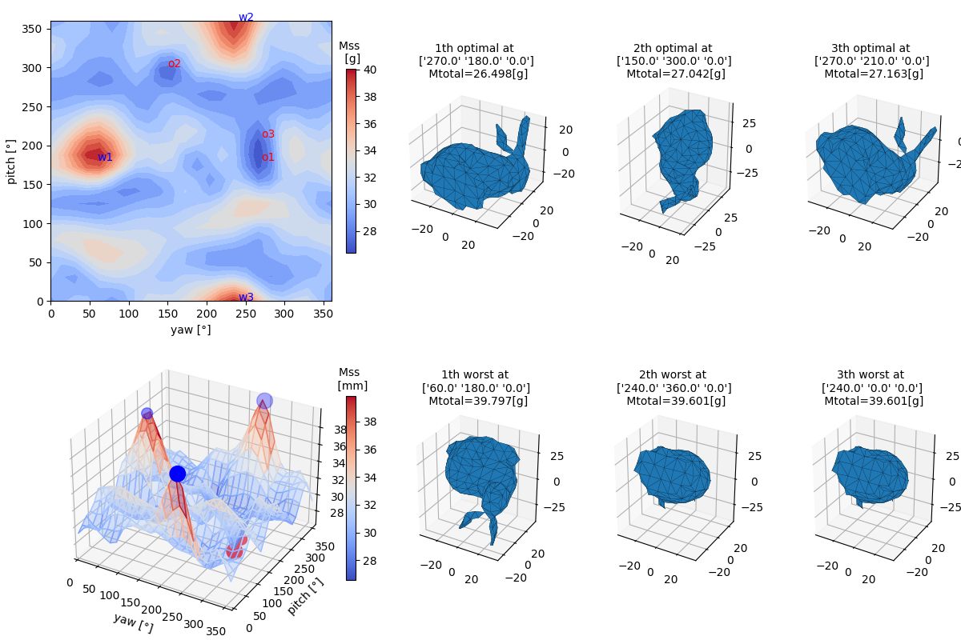
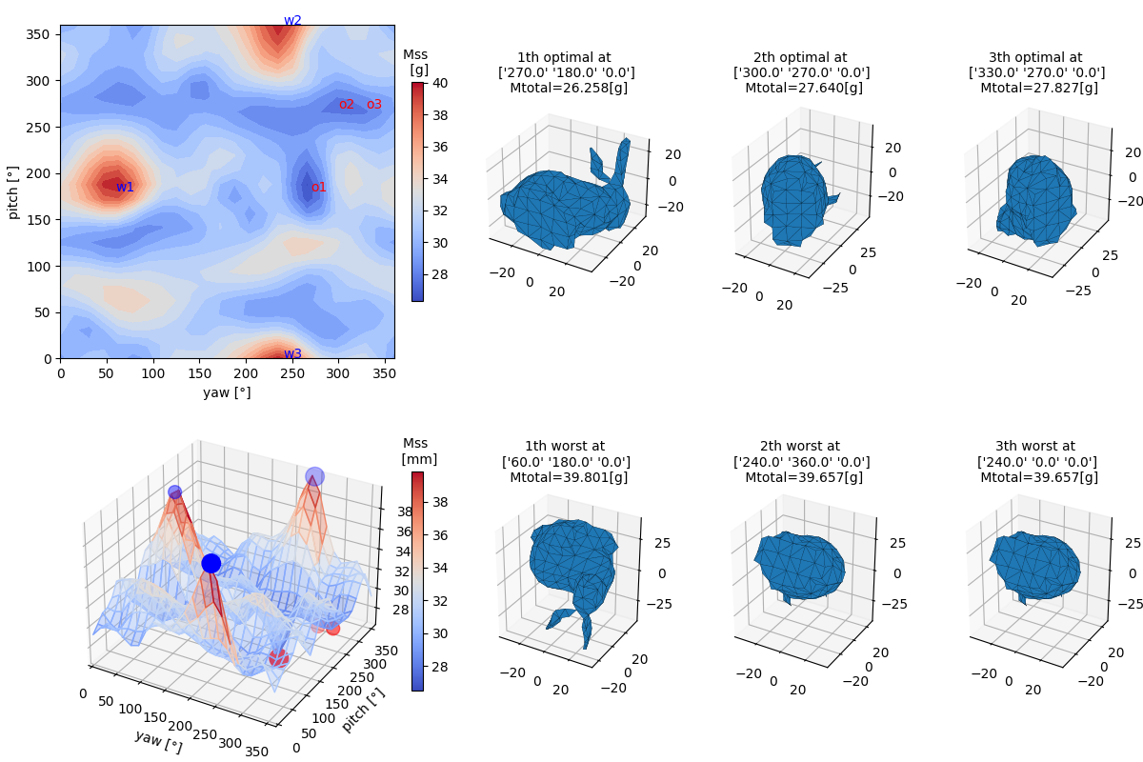
#5 Bunny 69k (30° interval, raft bottom structure)
slicing SW (3DWOX)
VSV
CVV2
CVV3
CVV1

